Slide 1

1.
This was caused due to a syntax error because I did not set the correct number to the last parameter see fix above

Slide 2
2.
This error was caused because I used the wrong field name but I also noticed that I used the wrong variable so I have changed that as well see fixes above

Slide 3

3.
Error has been thrown because I used the wrong variable see fixes above

Slide 4


4.
Booking has gone through with correct details with correct pricing

Slide 5
5.
Error occurred due to mismatched field names see fix above

Slide 6
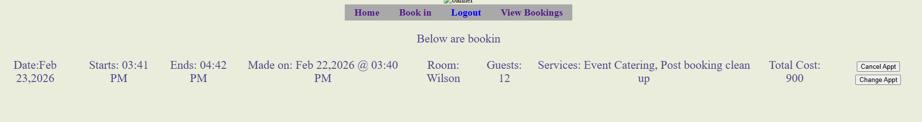
6.

Slide 7
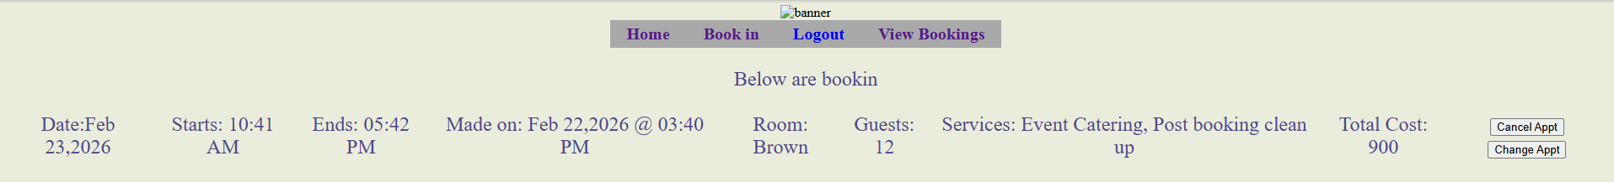
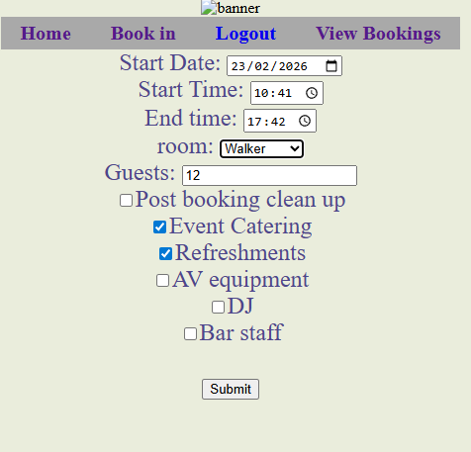
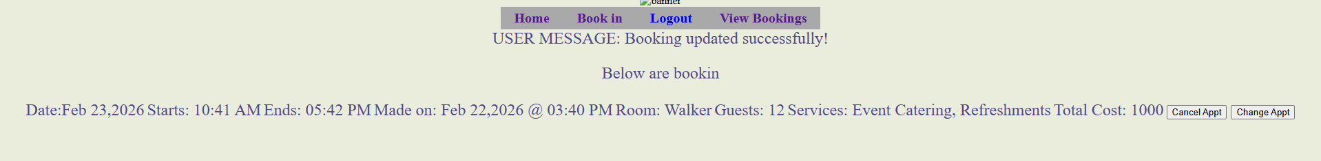
7.

Slide 8
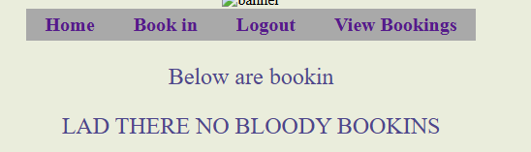
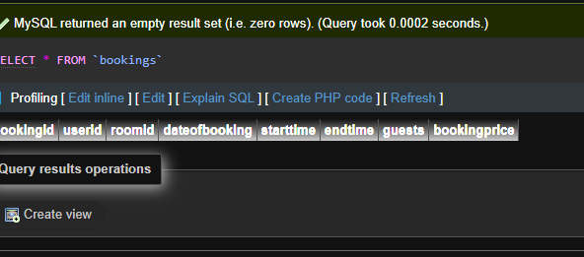
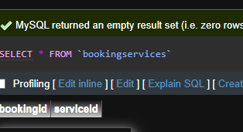
8.

Slide 9
5.

Slide 10
5.

Slide 11
5.

Slide 12
5.

Slide 13
5.

Slide 14
5.

Slide 15
5.

Slide 16
5.

Slide 17
5.

Slide 18
5.

Slide 19
5.

Slide 20
5.

Slide 21
5.

Slide 22
5.

Slide 23
5.

Slide 24
5.

Slide 25
5.

Slide 26
5.

